Slide 1
Face Recognition & Attendance System (Using Python OpenCV and Deep Neural Networks)
Shivam Chakravarti
M.Sc. (Mathematics & Scientific Computing)

Slide 2
Contents
What is Face Recognition
Different Methods of Recognizing Faces
Important Dependencies
Machine Learning & Deep Learning
Introduction to dlib & CNN
Implimenting Concepts towards the project
Observations and Outputs

Slide 3
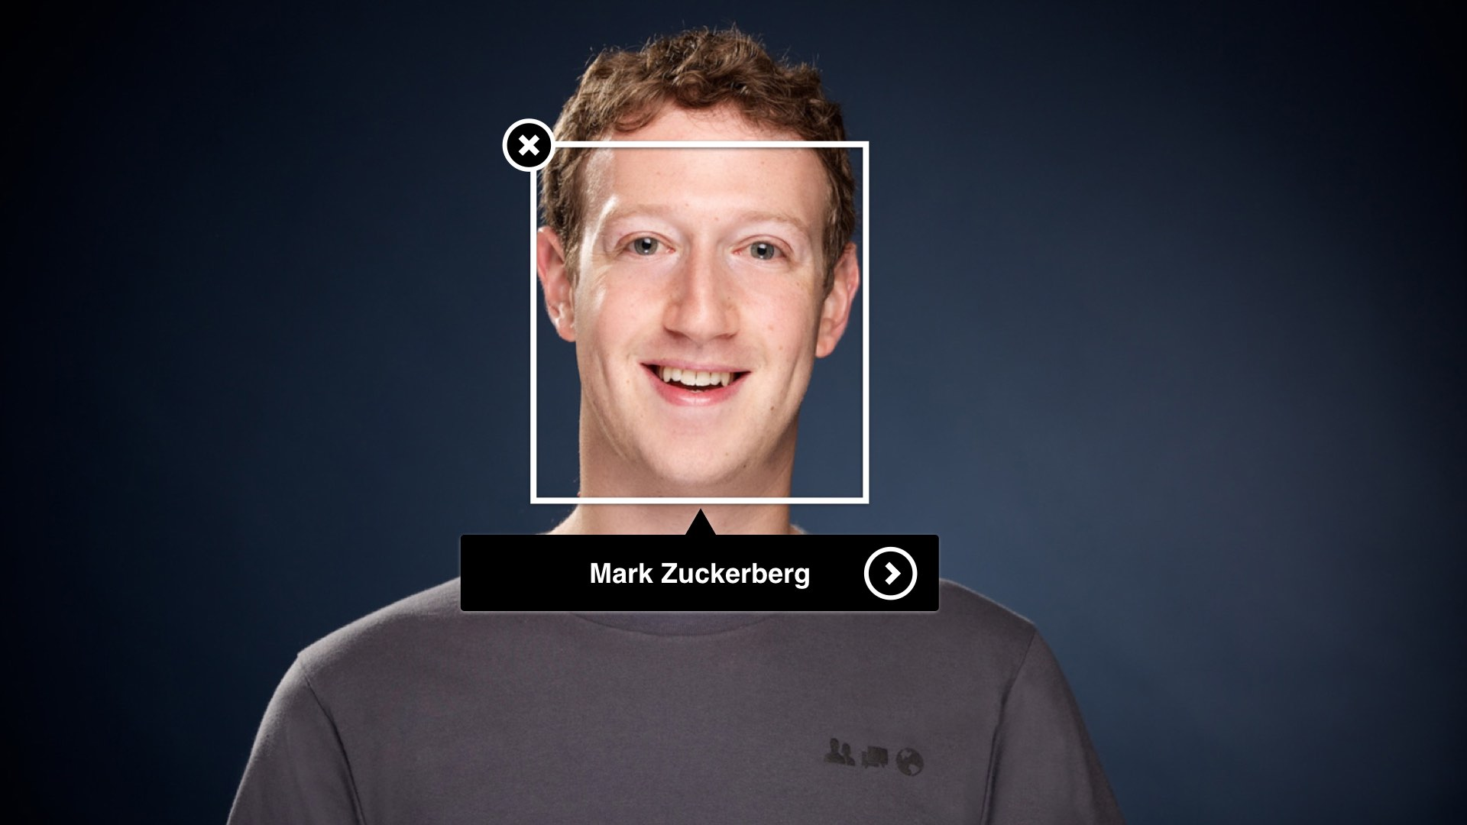
Face Recognition
Have you noticed that Facebook has developed an uncanny ability to recognize your friends in your photographs? In the old days, Facebook used to make you to tag your friends in photos by clicking on them and typing in their name. Now as soon as you upload a photo, Facebook tags everyone for you like magic:
This technology is called face recognition. Facebook’s algorithms are able to recognize your friends’ faces after they have been tagged only a few times.

Slide 4
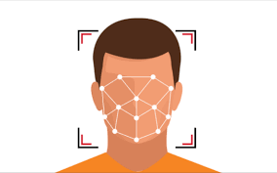
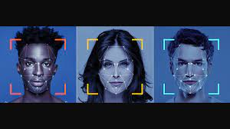
Face Recognition
Face recognition is the task of identifying an already detected object as a known or unknown face. Often the problem of face recognition is confused with the problem of face detection. Face Recognition on the other hand is to decide if the "face" is someone known, or unknown, using for this purpose a database of faces in order to validate this input face.

Slide 5
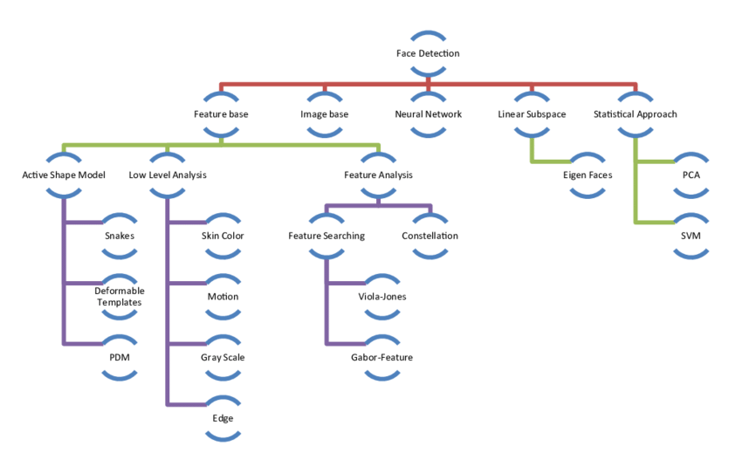

Slide 6
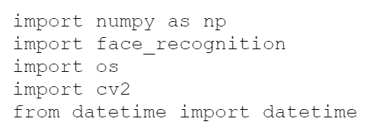

Important Dependencies
cmake
dlib
face_recognition
numpy
opencv-python
Importing into Python

Slide 7
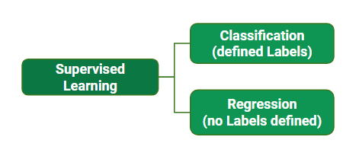
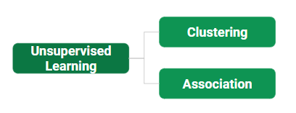
Machine Learning
Machine Learning is the field of study that gives computers the capability to learn without being explicitly programmed. ML is one of the most exciting technologies that one would have ever come across. As it is evident from the name, it gives the computer that makes it more similar to humans: The ability to learn. Machine learning is actively being used today, perhaps in many more places than one would expect.
Supervised learning is when the model is getting trained on a labelled dataset. A labelled dataset is one that has both input and output parameters. In this type of learning both training and validation, datasets are labelled.
Unsupervised learning is the training of a machine using information that is neither classified nor labeled and allowing the algorithm to act on that information without guidance. Here the task of the machine is to group unsorted information according to similarities, patterns, and differences without any prior training of data.

Slide 8
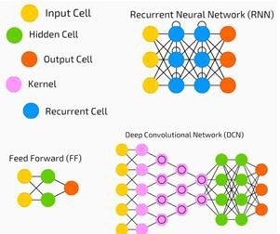
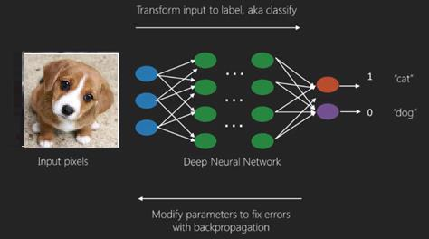
Deep Neural Networks
Neural networks are the core of deep learning, a field that has practical applications in many different areas. Today neural networks are used for image classification, speech recognition, object detection, etc.
Deep structured learning or hierarchical learning or deep learning in short is part of the family of machine learning methods which are themselves a subset of the broader field of Artificial Intelligence.
Deep learning is a class of machine learning algorithms that use several layers of nonlinear processing units for feature extraction and transformation. Each successive layer uses the output from the previous layer as input.
Deep neural networks, deep belief networks and recurrent neural networks have been applied to fields such as computer vision, speech recognition, natural language processing, audio recognition, social network filtering, machine translation, and bioinformatics where they produced results comparable to and in some cases better than human experts have.

Slide 9
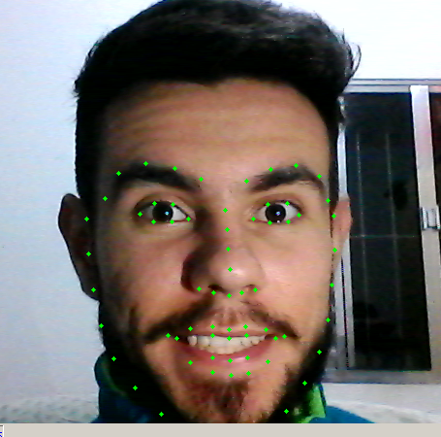
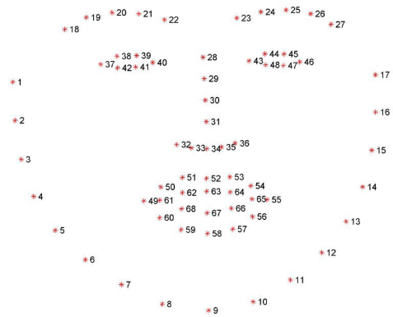
dlib Library
Dlib is a modern C++ toolkit containing machine learning algorithms and tools for creating complex software in C++ to solve real world problems.
It‘s a landmark’s facial detector with pre-trained models, the dlib is used to estimate the location of 68 coordinates (x, y) that map the facial points on a person’s face like image here.
http://dlib.net/dnn_face_recognition_ex.cpp.html
Refer to link for High quality Image Processing & Face Recognition

Slide 10

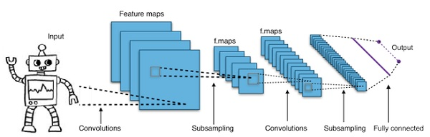
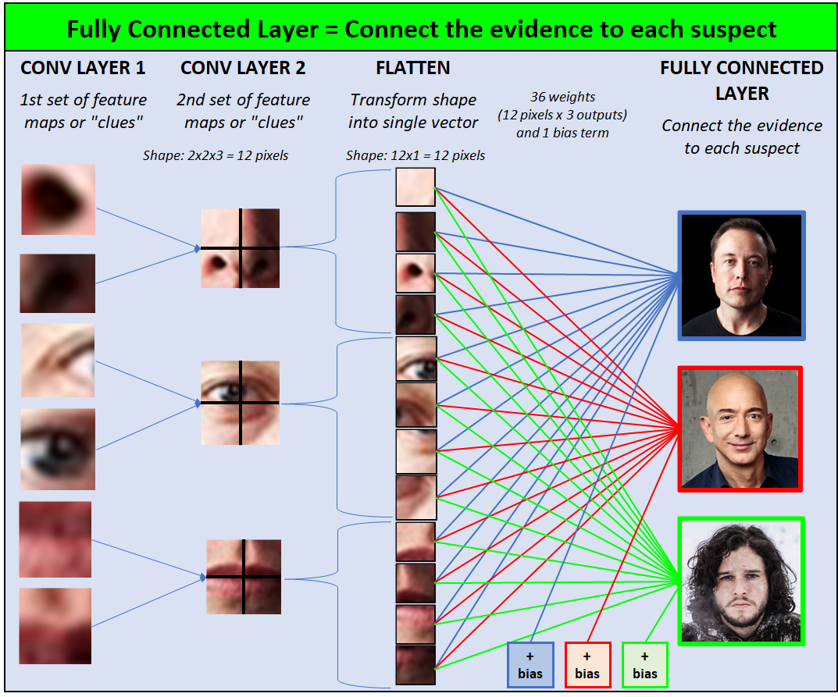
A Working Network of CNN (Convolutional Neural Network)
The different layers of a CNN. There are four types of layers for a convolutional neural network: the convolutional layer, the pooling layer, the ReLU correction layer and the fully-connected layer.

Slide 11
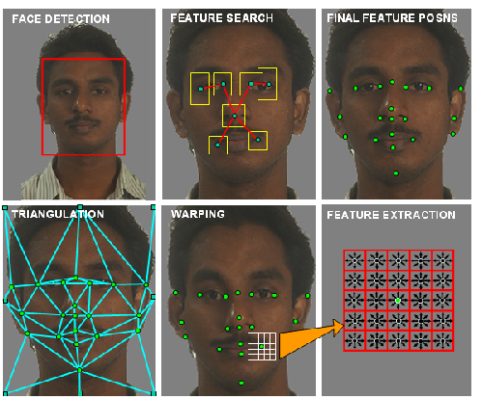
dlib includes two face detection methods built into the library:
A HOG + Linear SVM face detector that is accurate and computationally efficient.
A Max-Margin (MMOD) CNN face detector that is both highly accurate and very robust, capable of detecting faces from varying viewing angles, lighting conditions, and occlusion. This model requires significantly more computation (and is thus slower) but is much more accurate and robust to changes in face rotation and viewing angle.

Slide 12
Implication Steps
First, look at a picture and find all the faces in it
Second, focus on each face and be able to understand that even if a face is turned in a weird direction or in bad lighting, it is still the same person.
Third, be able to pick out unique features of the face that you can use to tell it apart from other people— like how big the eyes are, how long the face is, etc.
Finally, compare the unique features of that face to all the people you already know to determine the person’s name.

Slide 13
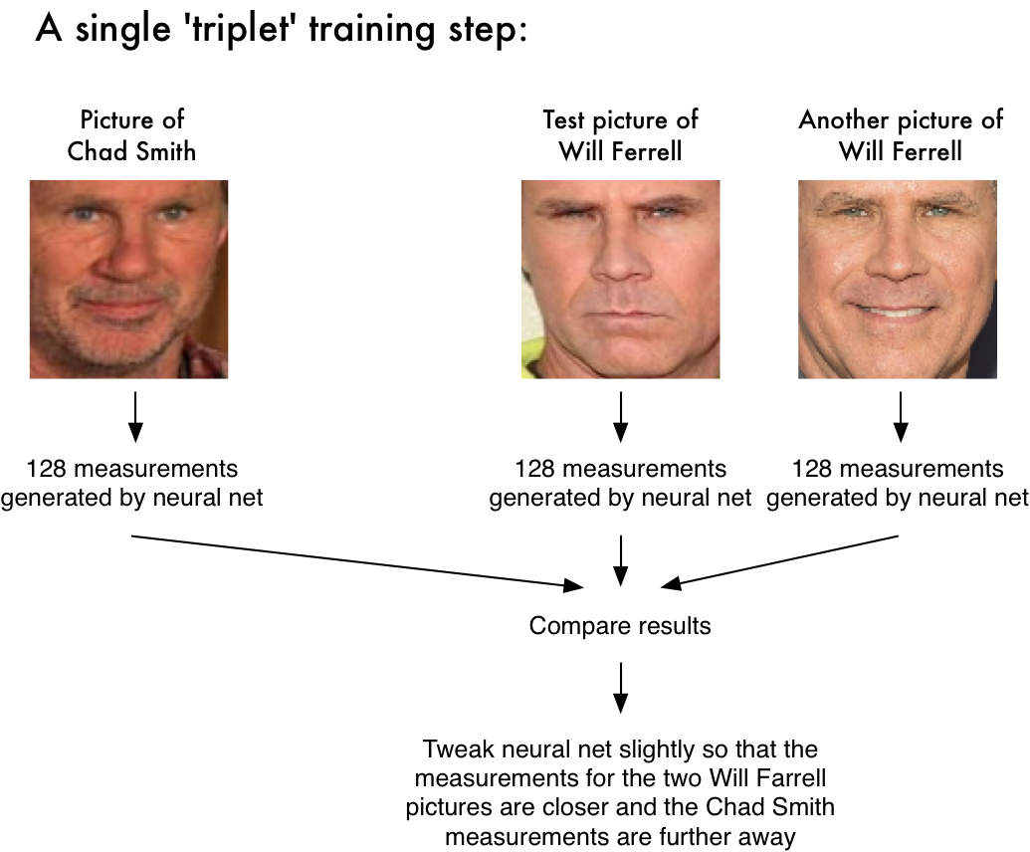

Slide 14
Face Recognition
To find faces in an image, we’ll start by making our image black and white because we don’t need color data to find faces.
Then we’ll look at every single pixel in our image one at a time. For every single pixel, we want to look at the pixels that directly surrounding it.
Our goal is to figure out how dark the current pixel is compared to the pixels directly surrounding it. Then we want to draw an arrow showing in which direction the image is getting darker.
If you repeat that process for every single pixel in the image, you end up with every pixel being replaced by an arrow. These arrows are called gradients and they show the flow from light to dark across the entire image.

Slide 15
First we will import the relevant libraries and then, the Process of Recognition can be divided into 3 steps:
Step 1: Loading Images and Converting to RGB
The Face Recognition package consists of a load image function that loads the image. Once imported the image has to be converted to RGB.
Step 2: Find Faces Locations and Encodings
In the second step we will use the true functionality of the face recognition library. First we will find the faces in our images . This is done using HOG (Histogram of Oriented Gradients) at the backend. Once we have the face they are warped to remove unwanted rotations. Then the image is feed to a pre-trained neural network that outputs 128 measurements that are unique to that particular face. The parts that the model measures is not known as this is what the model learns by itself when it was trained. Once we have the face locations and the encodings we can draw rectangles around our faces.
Step 3: Compare Faces and Find Distance
Once we have the encodings for both faces, then we can compare these 128 measurements of these two faces to find similarities. To compare the package uses one of the most common machine Learning methods linear SVM classifier. We can use the compare_faces function to find if the faces match. This function returns True or False. Similarly we can use the face-distance function to find how likely is the faces match in terms of numbers. This is helpul particularly when there are multiple faces to detect from.

Slide 16
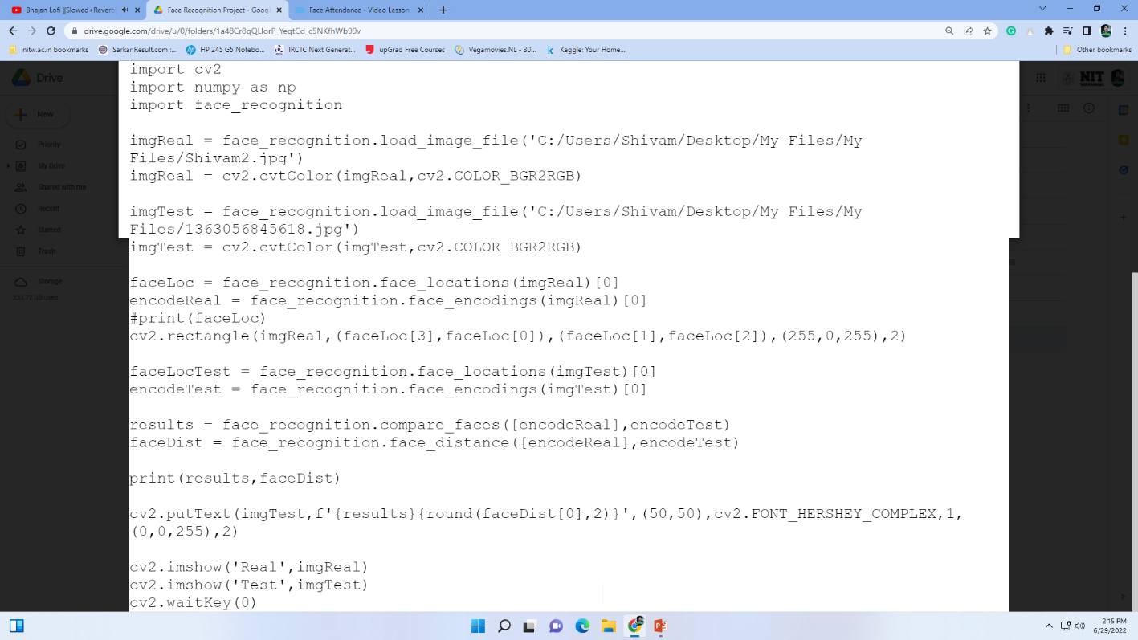
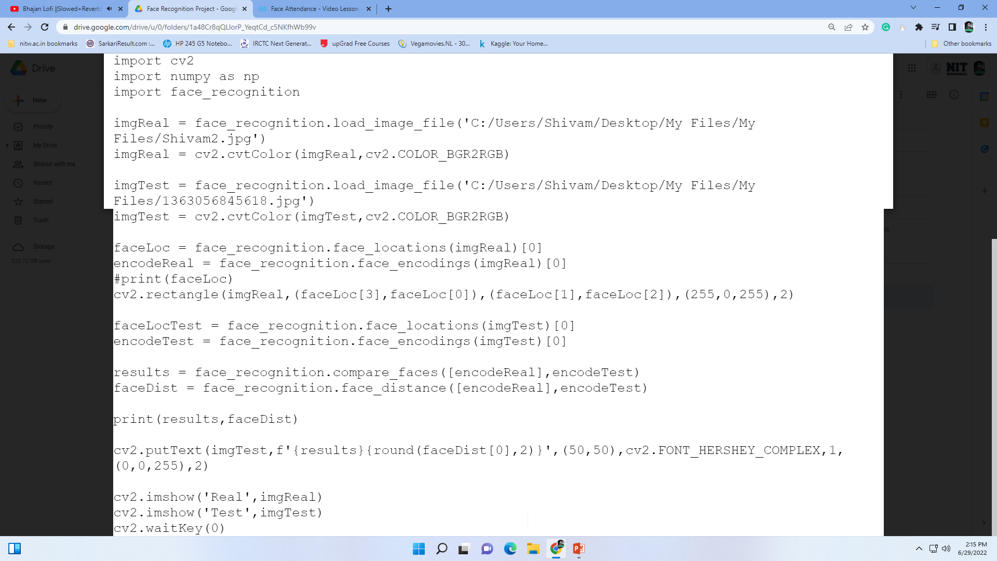

Slide 17
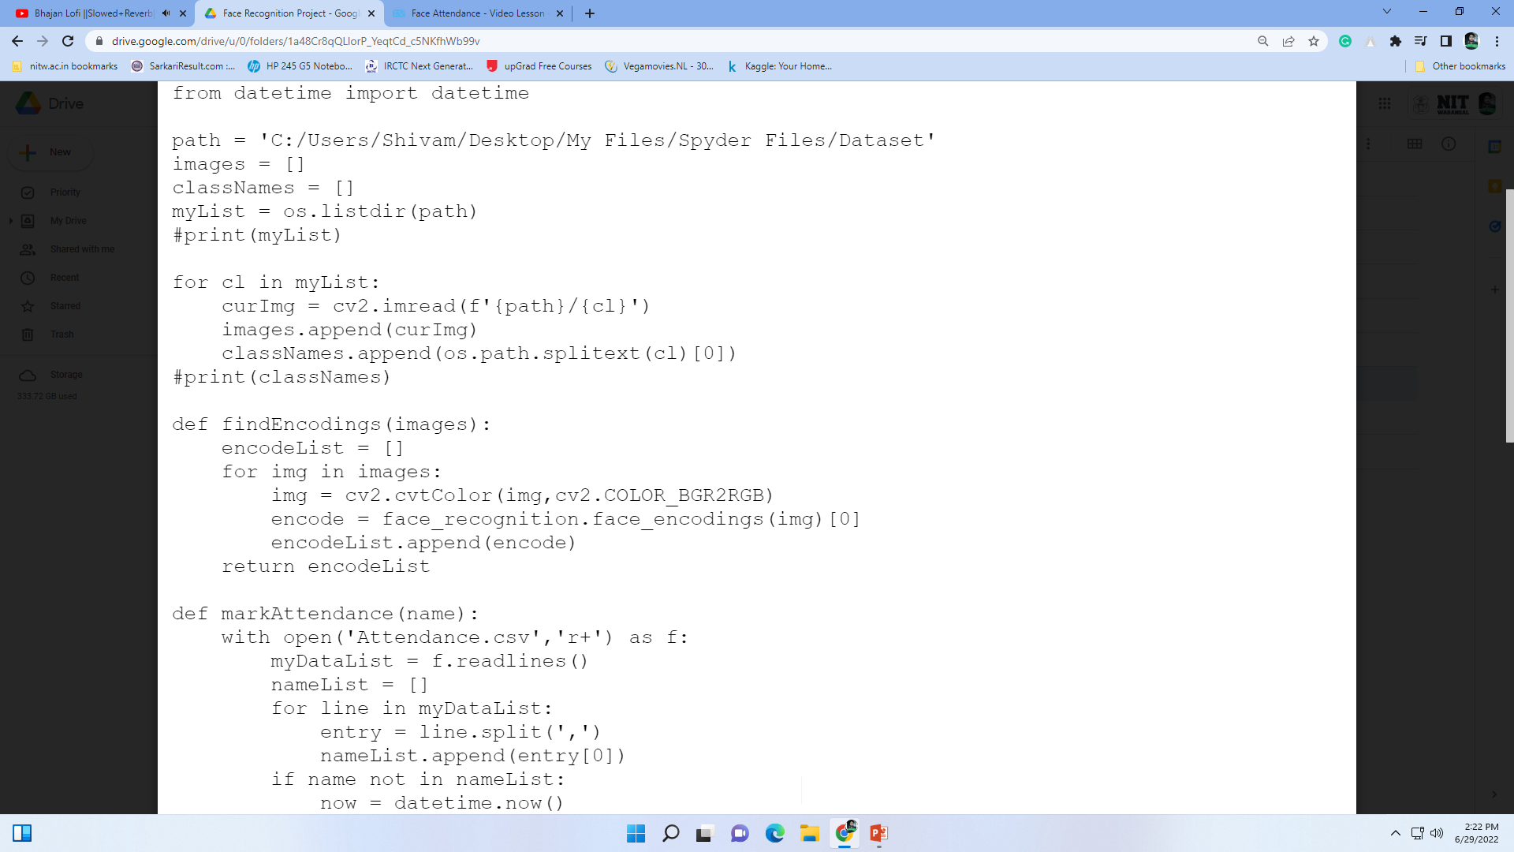
Attendance Project
Now using the methods we have seen above, we will develop an attendance system where the user is automatically logged when they are detected in the camera. We will store the name along with the time when they appeared.
Importing Images : As we have imported before we can use the same face_recognition.load_image_file() function to import our images. But when we have multiple images, importing them individually can become messy. Therefore we will write a script to import all images in a given folder at once. For this we will need the os library so we will import that first. We will store all the images in one list and their names in another.

Slide 18
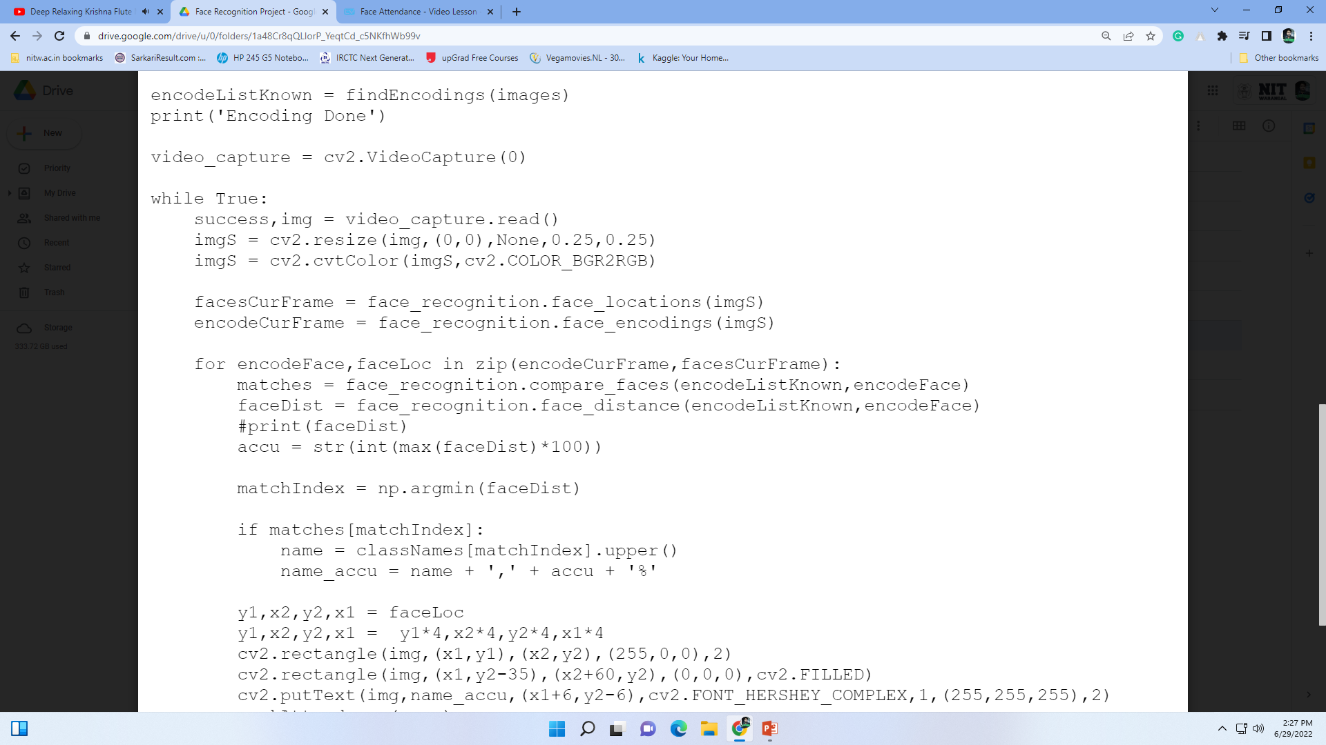
Compute Encodings : Now that we have a list of images we can iterate through those and create a corresponding encoded list for known faces. To do this we will create a function. As earlier we will first convert it into RGB and then find its encoding using the face_encodings( ) function. Then we will append each encoding to our list.
Now we can simply call this function with the images list as the input arguments.
The While loop : The while loop is created to run the webcam. But before the while loop we have to create a video capture object so that we can grab frames from the webcam.
First we will read the image from the webcam and then resize it to quarter the size. This is done to increase the speed of the system. Even though the image being used is 1/4 th of the original, we will still use the original size while displaying. Next we will convert it to RGB.

Slide 19
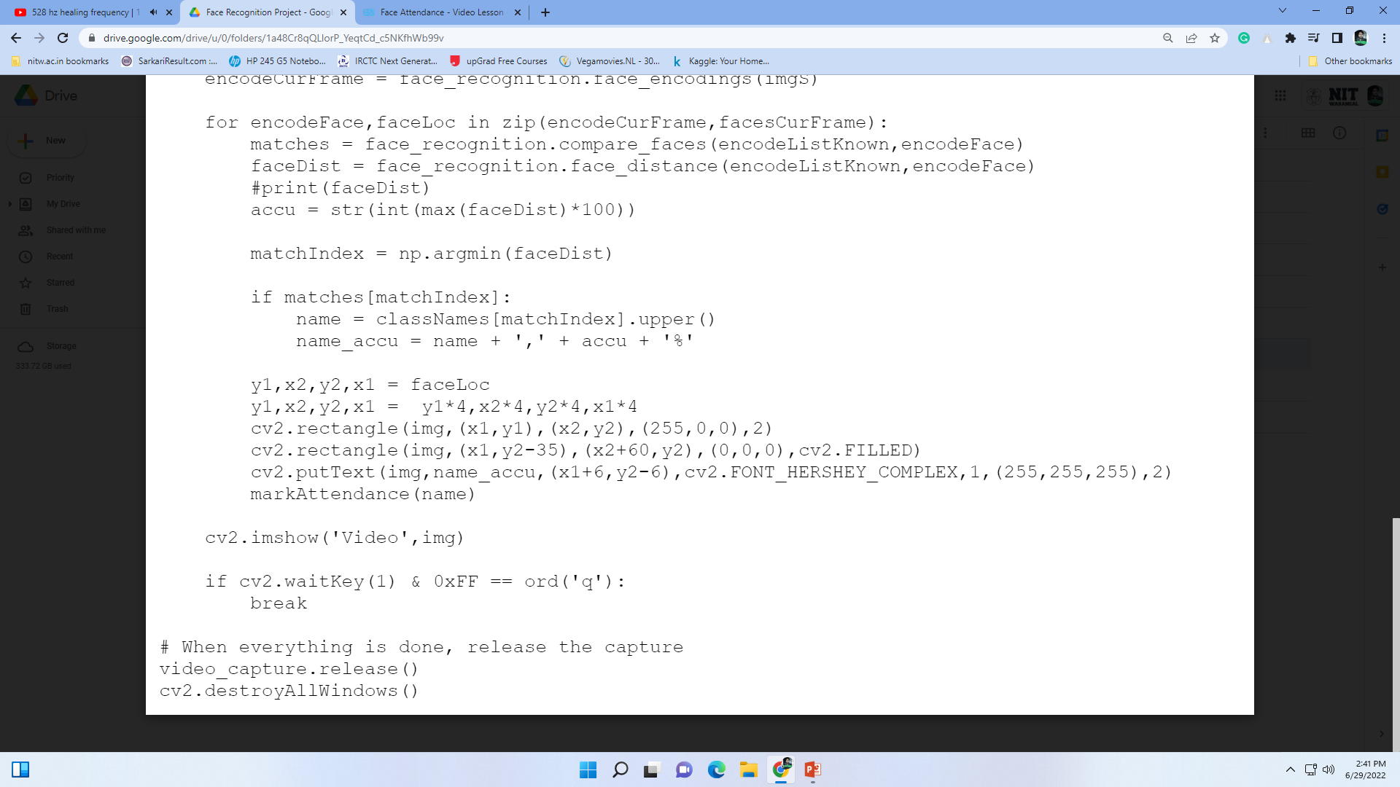
Once we have the webcam frame we will find all the faces in our image. The face_locations function is used for this purpose. Later we will find the face_encodings as well.
Now we can match the current face encodings to our known faces encoding list to find the matches. We will also compute the distance. This is done to find the best match in case more than one face is detected at a time. Once we have the list of face distances we can find the minimum one, as this would be the best match. Now based on the index value we can determine the name of the person and display it on the original Image.

Slide 20
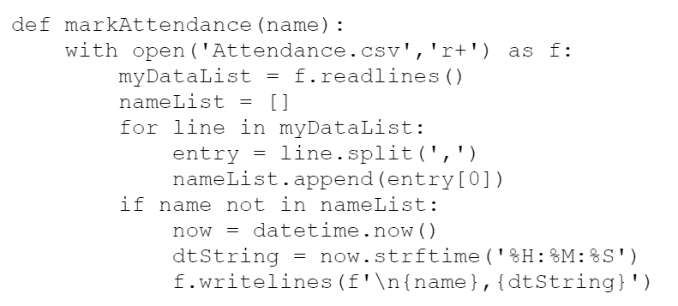
And finally, Mark the Attendance in the csv file
Marking Attendance : Lastly we are going to add the automated attendance code. We will start by writing a function that requires only one input which is the name of the user. First we open our Attendance file which is in csv format. Then we read all the lines and iterate through each line using a for loop. Next we can split using comma ‘,’. This will allow us to get the first element which is the name of the user. If the user in the camera already has an entry in the file then nothing will happen. On the other hand if the user is new then the name of the user along with the current time stamp will be stored. We can use the datetime class in the date time package to get the current time.

Slide 21
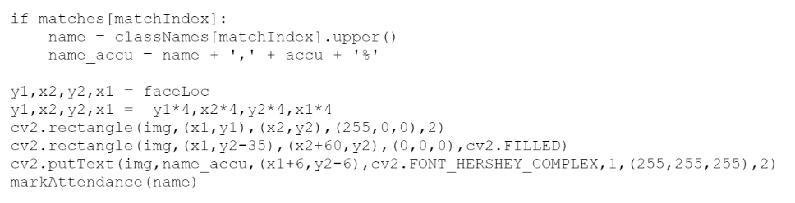
Labeling Unknown faces as well
if faceDis&#91;matchIndex]&lt; 0.50:
name = classNames&#91;matchIndex].upper()
markAttendance(name)
else: name = 'Unknown'
#print(name)
y1,x2,y2,x1 = faceLoc
y1, x2, y2, x1 = y1*4,x2*4,y2*4,x1*4
cv2.rectangle(img,(x1,y1),(x2,y2),(0,255,0),2)
cv2.rectangle(img,(x1,y2-35),(x2,y2),(0,255,0),cv2.FILLED)
cv2.putText(img,name,(x1+6,y2-6),cv2.FONT_HERSHEY_COMPLEX,1,(255,255,255),2)

Slide 22
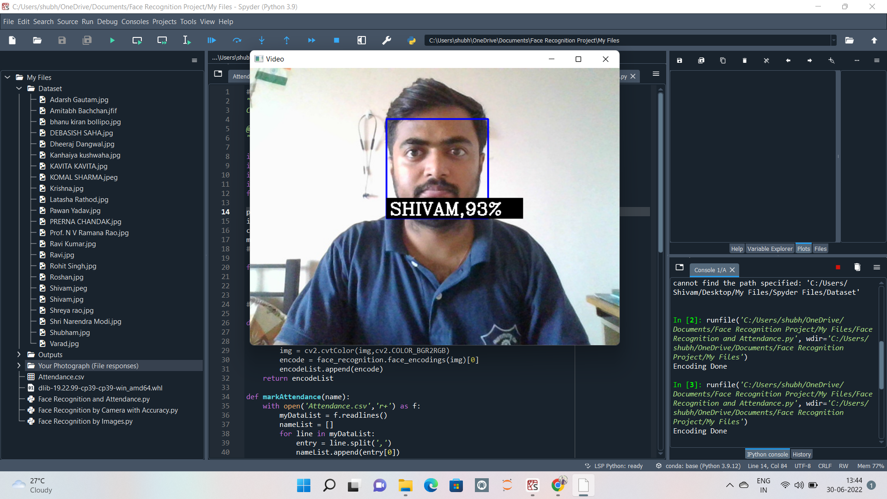
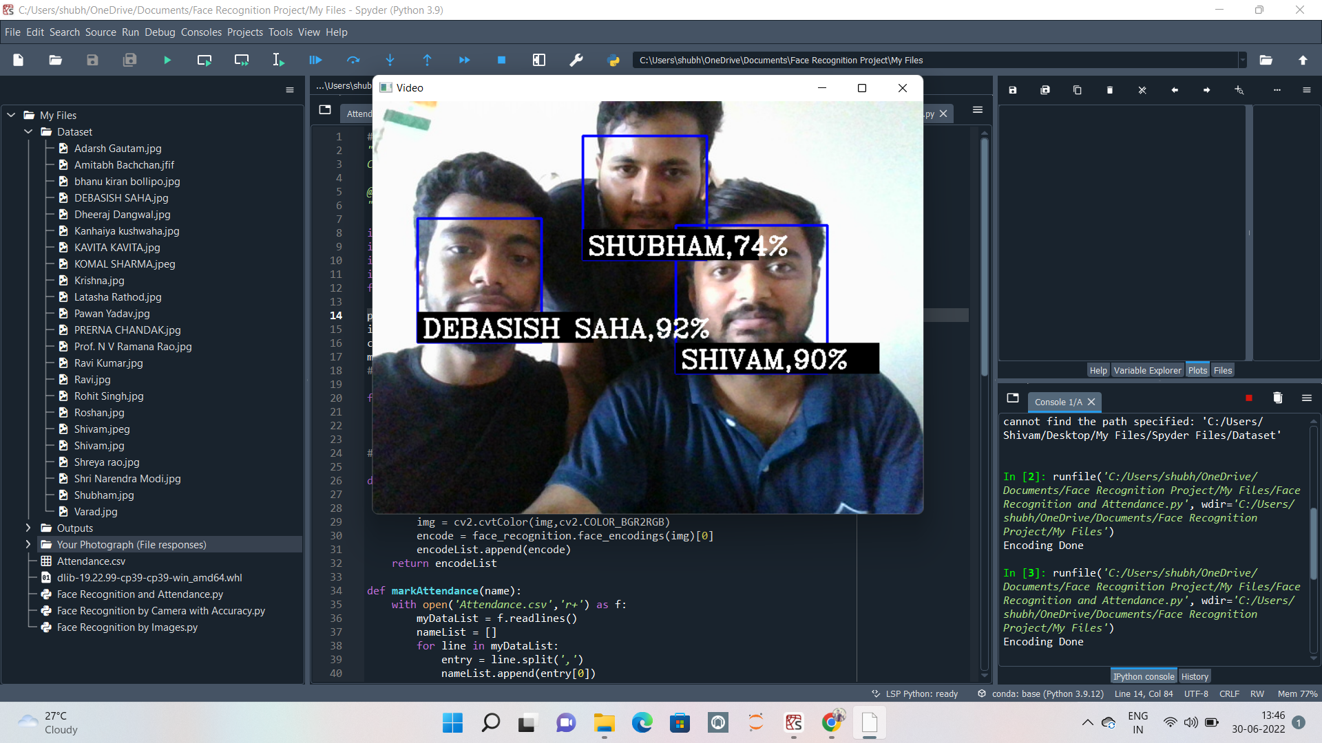
Results/Outputs
After implicating the all steps, the observations are given here:
Capture 1
Capture 2.1

Slide 23
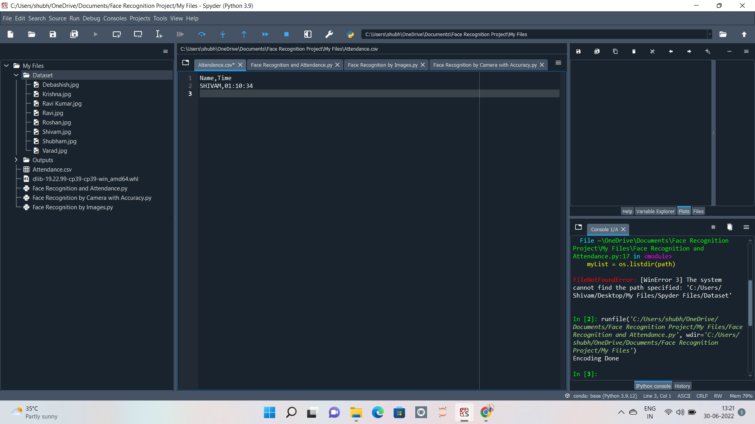
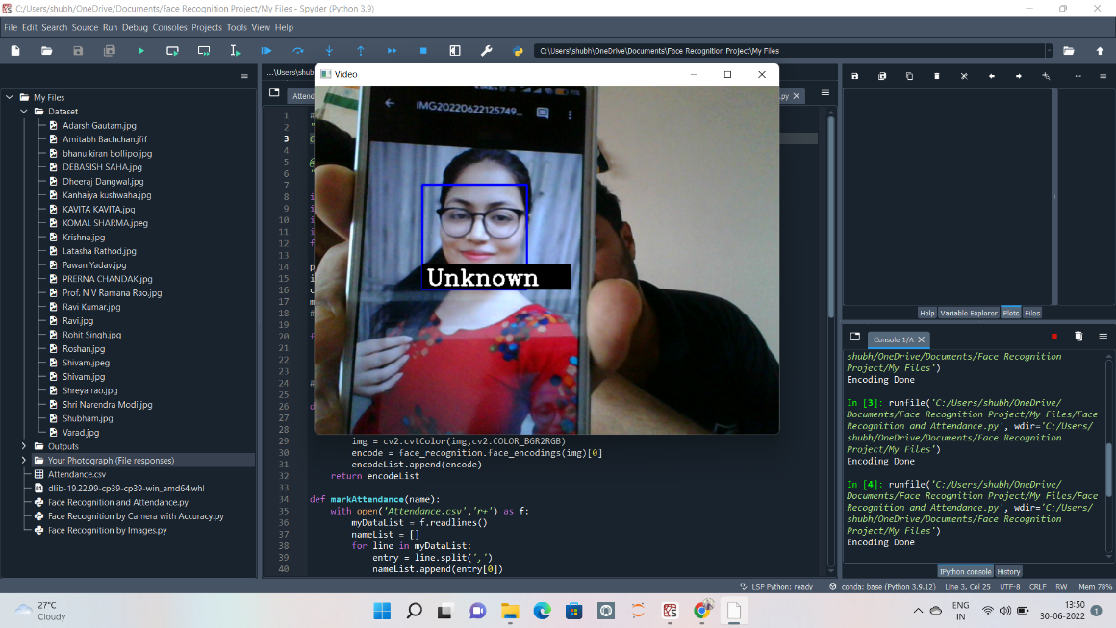
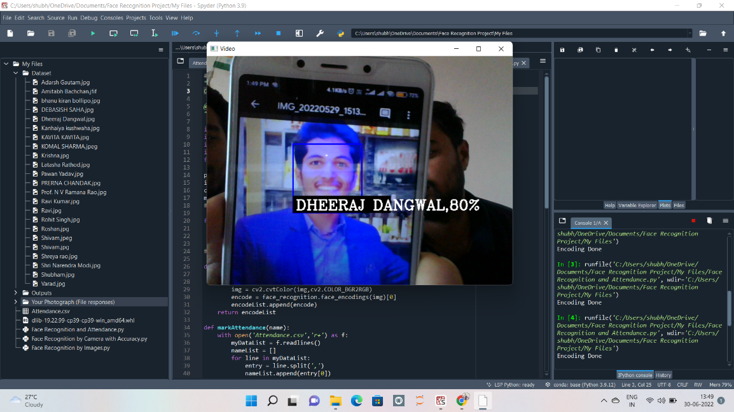
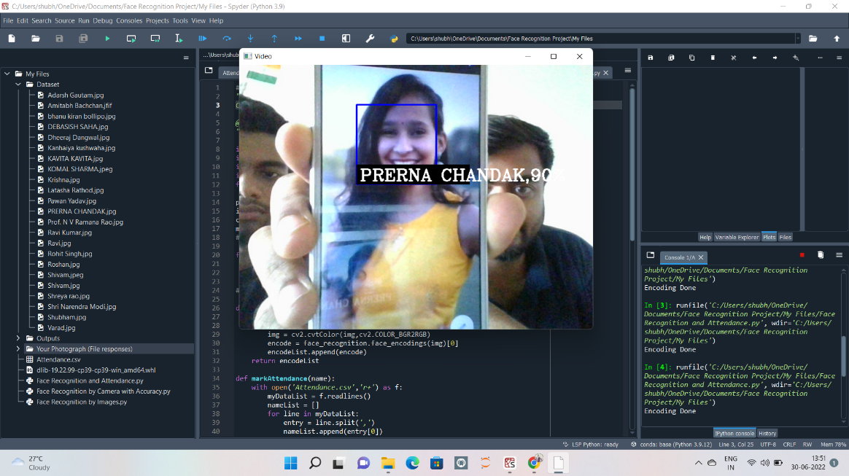
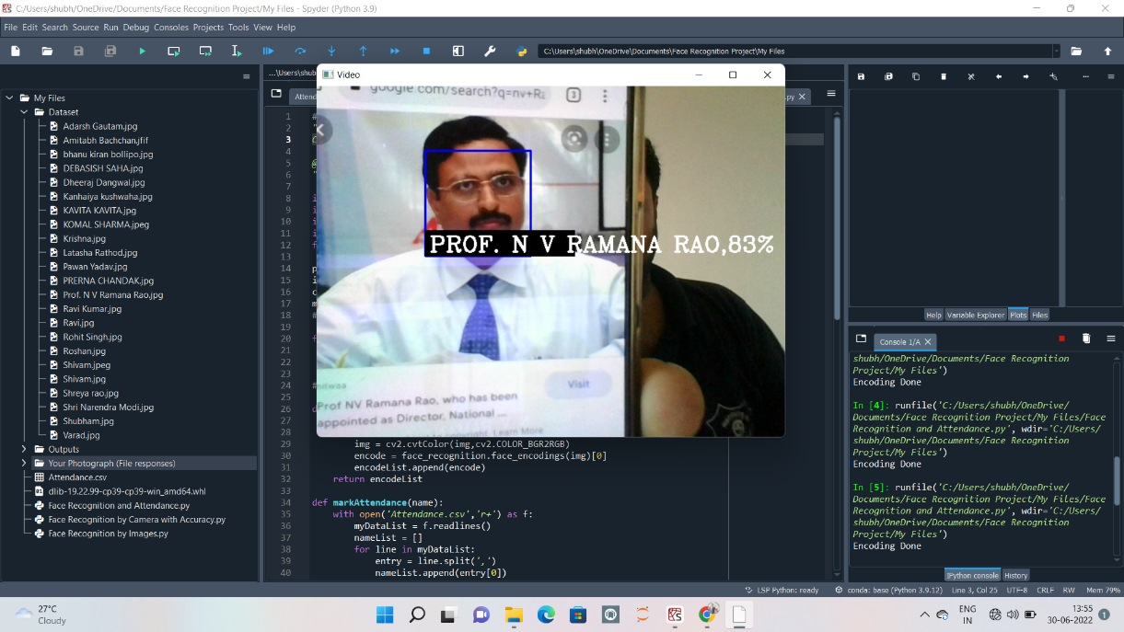
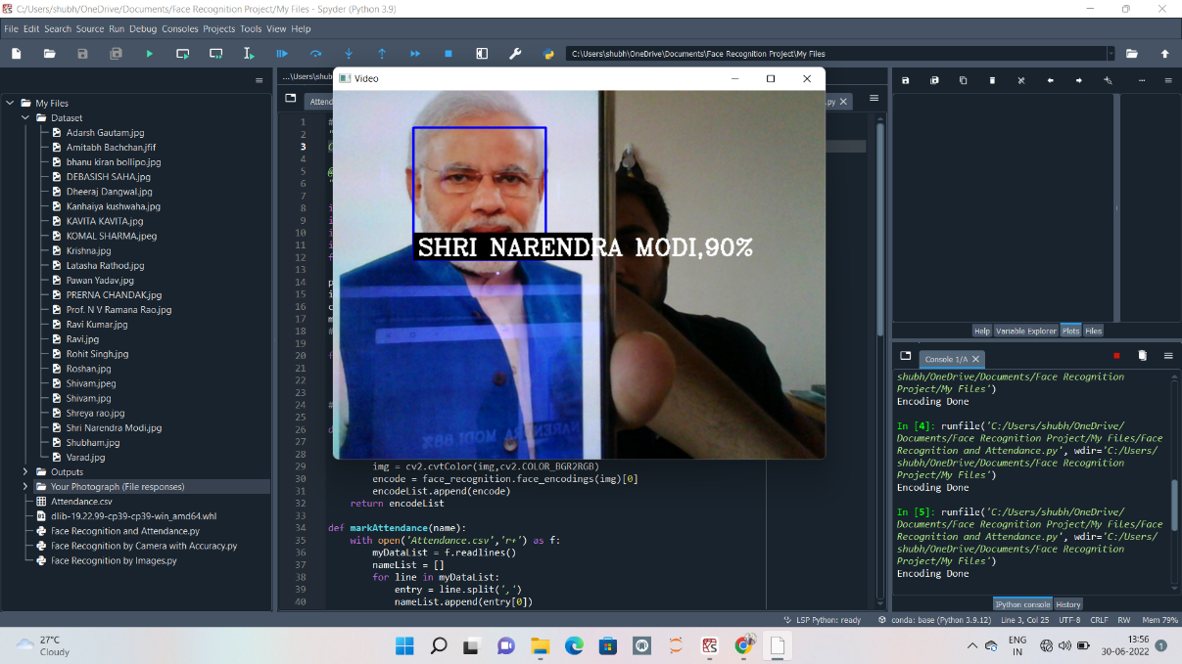
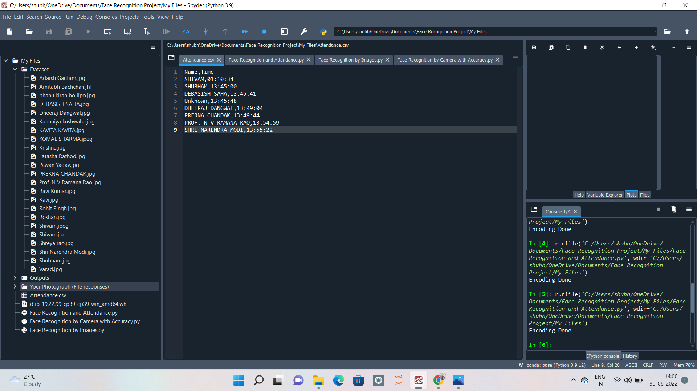
Attendance Record for Capture 1
Capture 2.2
Capture 2.3
Capture 2.4
Capture 2.5
Capture 2.6
Attendance Record for Capture 2

Slide 24

Final Record in Excel Sheet

Slide 25
References
Machine Learning is Fun! Part 4: Modern Face Recognition with Deep Learning ; an Article by Adam Geitgey (medium.com)
Face detection with dlib (HOG and CNN) by Adrian Rosebrock on April 19, 2021 (pyimagesearch)
Face recognition with OpenCV, Python, and deep learning by Adrian Rosebrock on June 18, 2018 (pyimagesearch)
Face Detection and Recognition: Theory and Practice ; Book by Asit Kumar Datta, Madhura Datta, and Pradipta Kumar Banerjee

